Slide 1

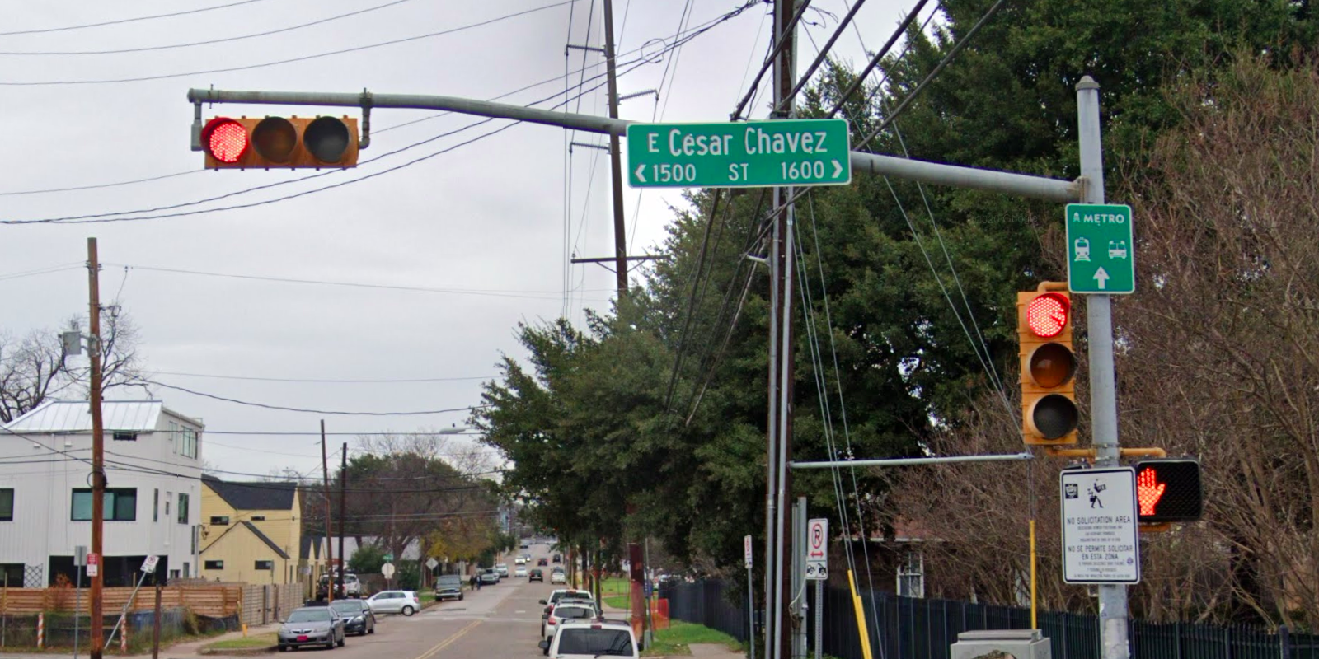
Austin Transportation Department Signs Work Orders
Created By: Susanne Gov Created Date: 2020-08-10 Location Name: CESAR CHAVEZ ST / COMAL ST Intersection ID: 5159056 Cardinal Direction: N
Sign Type | Install/Remove
Street Name Sign | Install
Metro | Install

Slide 2
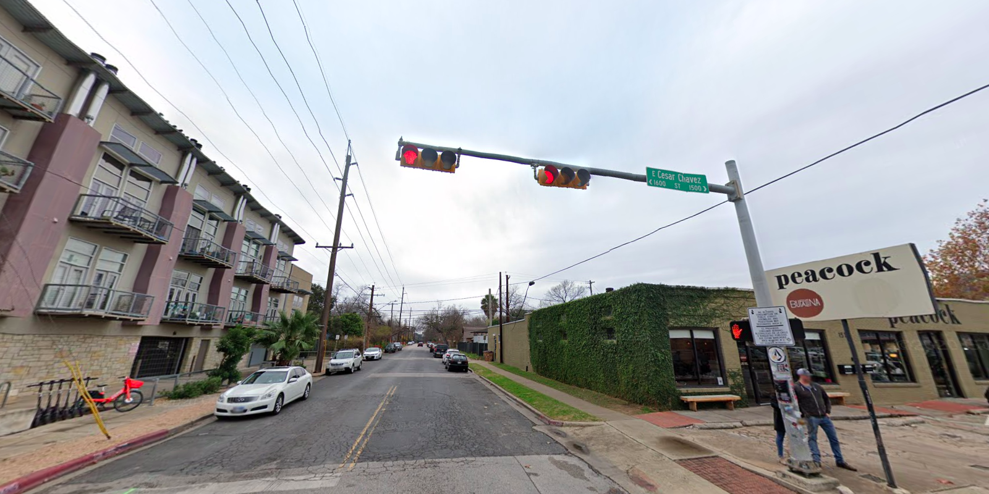
Austin Transportation Department Signs Work Orders
Created By: Susanne Gov Created Date: 2020-08-10 Location Name: CESAR CHAVEZ ST / COMAL ST Intersection ID: 5159056 Cardinal Direction: S
Sign Type | Install/Remove
Street Name Sign | Install

Slide 3
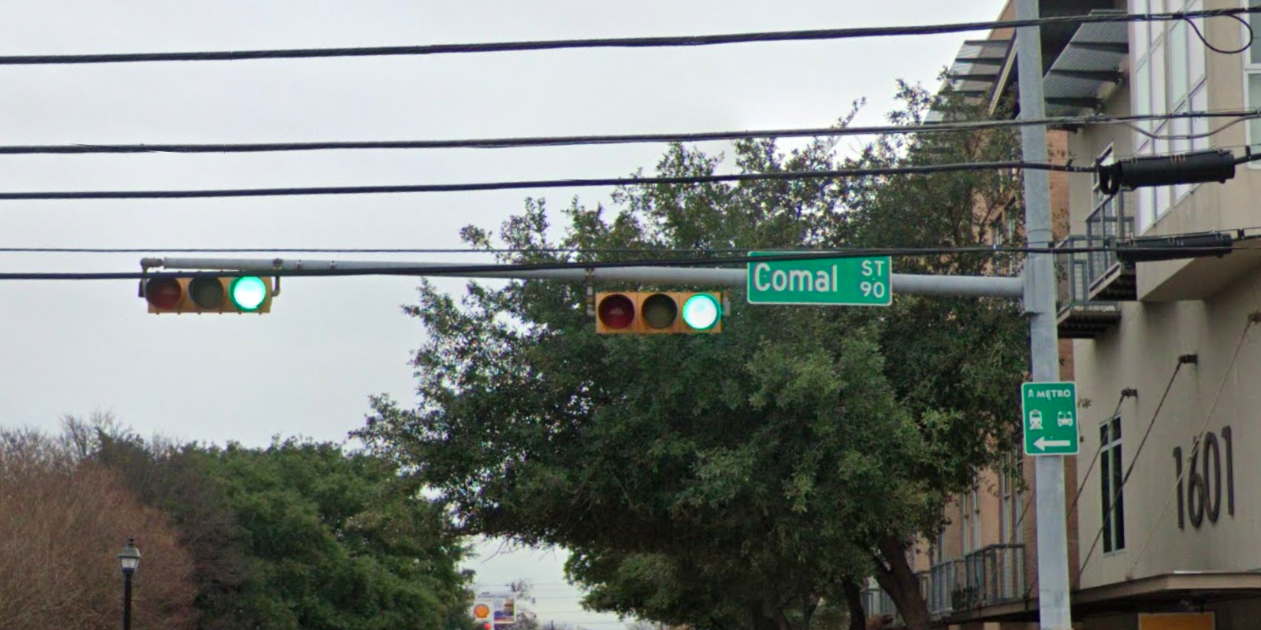
Austin Transportation Department Signs Work Orders
Created By: Susanne Gov Created Date: 2020-08-10 Location Name: CESAR CHAVEZ ST / COMAL ST Intersection ID: 5159056 Cardinal Direction: E
Sign Type | Install/Remove
Street Name Sign | Install
Metro | Install

Slide 4
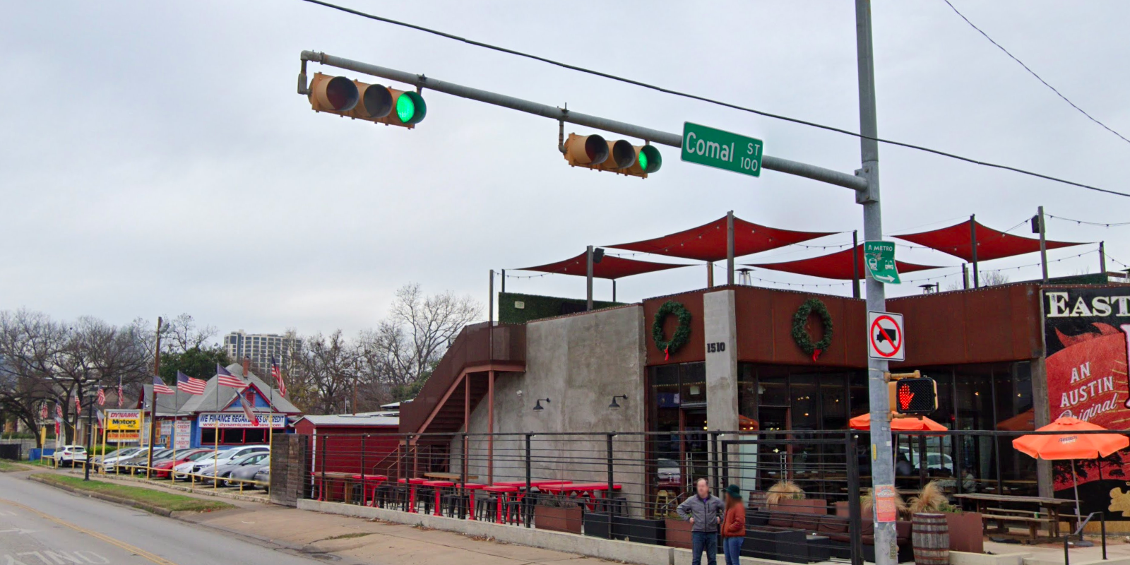
Austin Transportation Department Signs Work Orders
Created By: Susanne Gov Created Date: 2020-08-10 Location Name: CESAR CHAVEZ ST / COMAL ST Intersection ID: 5159056 Cardinal Direction: W
Sign Type | Install/Remove
Street Name Sign | Install
Metro | Install
No Truck Symbol | Install

